Slide 1
GO Team Budget Allocation Meeting January 2025

Slide 2
Agenda
Call to order
Roll Call; Establish Quorum
Action Items
Approval of Agenda:
Approval of Previous Minutes:
Discussion Items
Review Budget Meeting Schedule
Review and update meeting calendar (if necessary) to meet District’s timeline (draft budget must be completed by February 14 and approval meeting cannot be held until after the Staffing Conference)
Budget Allocation Presentation
Information Items
Principal’s Report
CCRPI
Committee Reports
Uniform Committee
Cluster Advisory Meeting Report
Announcements
Public Comment
Adjournment

Slide 3
Action Items: Preparing for Budget Development

Slide 4
Strategic Plan with rank priority
A caring school embracing community, respect, honesty and hard work.
F. A. Toomer
Strategic Plan
2021-2025
(updated for 2025-2026)
At Toomer, we cultivate global citizens and life-long learners through inquiry, voice, choice, and agency. We provide a safe and equitable community that embraces diversity to inspire students to become critical agents of change.
SMART Goals
Reading
Increase the % of grades 3-5 students scoring proficient or above in reading from 25% to 35% by 2025
Math
Increase the % of grades 3-5 students scoring proficient or above in math from 25% to 35% by 2025
Behavior
The number of out of school suspensions will decrease from 29 days to 15 days by 2025
APS Strategic Priorities & Initiatives
School Strategic Priorities
School Strategies
Fostering Academic Excellence for All
Data
Curriculum & Instruction
Signature Program
1. Intentionally focus on closing the sub groups achievement gaps.
2. Implement research-based teaching strategies supported by student data.
3. Create a system of supporting problem solving and action with students and staff through the lens of IB.
4.. Develop and implement a parent engagement plan, based on mutual communication and impact data.
5. Create and implement a system that promotes equitable practices in all areas of the school community.
-Weekly IB Unit Planning & Reflection
-Mid-Year intervention Plans & data review
-Equity Team/Monthly Meetings
-Intentional 360 instruction around individual learning gaps
-Develop conceptual learning & implementing research based mathematical teaching & learning practices
Building a Culture of Student Support
Whole Child & Intervention
Personalized Learning
-Safety patrol/Restorative student leaders
-Restorative practice committee/Coach next year
-Develop student clubs with clear objectives
6. Foster a system of restorative practices that include students, staff, and families and all wrap around services.
7. Implement a robust wrap around program with clear goals, communication plan, and measurement structure.
-IB Training
-Create pipeline for aspiring leaders through flexible master teacher teams
-Differentiated professional learning & vertical monthly Teaming
-Clearly flesh out new teacher mentor program (Teacher rounds)
Equipping & Empowering Leaders & Staff
Strategic Staff Support
Equitable Resource Allocation
8. Create and support a development path for all staff that includes school based leadership.
9. Foster a “whole adult” system of support.
10. Foster the culture of individualized support for all staff members.
Creating a System of School Support
Collective Action, Engagement & Empowerment
11. Create a mentorship programs for students and staff, students and students, students and parents.
12. Foster a culture of staff, student, parent, and community voice.
-Monthly community engagement
Community coffees
-Student-Led restorative practice group
Quarterly student learning showcase

Slide 5
Discussion Items

Slide 6
Review & Discuss FY26 GO Team Budget Meeting Schedule
To ensure alignment with the district's budget timeline, we need to review and potentially adjust our current budget meeting schedule. This will ensure timely submission of all required materials.

Slide 7
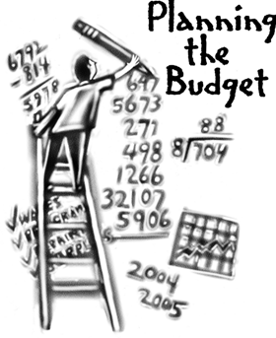
Overview of the FY26 GO Team Budget Process
Step 8* GO Team Final Budget Approval Meeting
Budgets Approved by March 14
Step 7 Principals HR Staffing Conferences Begin
Feb. 24 - 27
Step 6 Cluster Supt. Review February 17-21
Step 5* GO Team Feedback Mtg. Feb 10 - 14
Step 4 Principals Cluster Supt. Discussions
Step 3 GO Team Budget Allocation Meeting
January 15 – January 31
Step 2 Principals Workshop FY 26 Budget
January 15
Step 1 Update Strategic Plan & Rank Priorities
GO Teams are encouraged to have ongoing conversations
* GO Teams will need to take ACTION on the budget at these meetings.

Slide 8
Action on GO Team Budget Meeting Calendar
We will need to take ACTION (vote) to change our meeting calendar if we need to change our meetings to meet these deadlines:
Allocation Meeting: now-Jan 31
Feedback Meeting: February10 - 14
Approval Meeting: after staffing conference and before Friday, March 14.

Slide 9
Budget Development

Slide 10
Norms
This is a meeting of the GO Team. Only members of the team may participate in the discussion. Any members of the public present are here to quietly observe.
We will follow the agenda as noticed to the public and stay on task.
We invite and welcome contributions of every member and listen to each other.
We will respect all ideas and assume good intentions.

Slide 11
GO Team Budget Development Process
YOUR SCHOOL STRATEGIC PLAN…
is your roadmap and your role.
It is your direction, your priorities, your vision,
your present, your future.
Step 1: Data Review
Step 2: Strategic Plan Review
Step 3: Budget Parameters
(Strategic Priorities)
Step 4: Budget Development Process

Slide 12
Budget Allocation Meeting
What
During the first GO Team meeting the principal will provide an overview of the budget and position allocations, request(s) for turnaround and/or signature program funds and review changes to the Gifted Services delivery model (as needed)
Why
This meeting provides an opportunity for the principal and GO Team to ensure alignment on the school’s key strategic priorities, gain a deeper understanding of the budget and position allocations, discuss the proposed requests for signature program funds and provide input to drive the development of the draft budget.
When
January 16 – January 31

Slide 13
FY26 Budget Development Process
Principal’s Role
Design the budget and propose operational changes that can raise student achievement
Formulate strategies, implement and manage them at the school level
Focus on the day-to-day operations
Serve as the expert on the school
Hire quality instructional and support personnel
Collaborate with the GO Team on the use of school-level flexibility for position allocations, turnaround initiatives, and Signature Programs (NEW PROCESS FOR FY26)
The GO Team’s Role
Focus on the big picture (positions and resources, not people)
Ensure that the budget is aligned to the school’s mission and vision and that resources are allocated to support key strategic priorities
Collaborate with the Principal on the use of school-level flexibility for position allocations, turnaround initiatives, and Signature Programs (NEW PROCESS FOR FY26)

Slide 14
Strategic Plan with rank priority
A caring school embracing community, respect, honesty and hard work.
F. A. Toomer
Strategic Plan
2021-2025
(updated for 2025-2026)
At Toomer, we cultivate global citizens and life-long learners through inquiry, voice, choice, and agency. We provide a safe and equitable community that embraces diversity to inspire students to become critical agents of change.
SMART Goals
Reading
Increase the % of grades 3-5 students scoring proficient or above in reading from 25% to 35% by 2025
Math
Increase the % of grades 3-5 students scoring proficient or above in math from 25% to 35% by 2025
Behavior
The number of out of school suspensions will decrease from 29 days to 15 days by 2025
APS Strategic Priorities & Initiatives
School Strategic Priorities
School Strategies
Fostering Academic Excellence for All
Data
Curriculum & Instruction
Signature Program
1. Intentionally focus on closing the sub groups achievement gaps.
2. Implement research-based teaching strategies supported by student data.
3. Create a system of supporting problem solving and action with students and staff through the lens of IB.
4.. Develop and implement a parent engagement plan, based on mutual communication and impact data.
5. Create and implement a system that promotes equitable practices in all areas of the school community.
-Weekly IB Unit Planning & Reflection
-Mid-Year intervention Plans & data review
-Equity Team/Monthly Meetings
-Intentional 360 instruction around individual learning gaps
-Develop conceptual learning & implementing research based mathematical teaching & learning practices
Building a Culture of Student Support
Whole Child & Intervention
Personalized Learning
-Safety patrol/Restorative student leaders
-Restorative practice committee/Coach next year
-Develop student clubs with clear objectives
6. Foster a system of restorative practices that include students, staff, and families and all wrap around services.
7. Implement a robust wrap around program with clear goals, communication plan, and measurement structure.
-IB Training
-Create pipeline for aspiring leaders through flexible master teacher teams
-Differentiated professional learning & vertical monthly Teaming
-Clearly flesh out new teacher mentor program (Teacher rounds)
Equipping & Empowering Leaders & Staff
Strategic Staff Support
Equitable Resource Allocation
8. Create and support a development path for all staff that includes school based leadership.
9. Foster a “whole adult” system of support.
10. Foster the culture of individualized support for all staff members.
Creating a System of School Support
Collective Action, Engagement & Empowerment
11. Create a mentorship programs for students and staff, students and students, students and parents.
12. Foster a culture of staff, student, parent, and community voice.
-Monthly community engagement
Community coffees
-Student-Led restorative practice group
Quarterly student learning showcase

Slide 15
FY 26 Budget Parameters
FY26 Ranked School Priorities | Rationale
Intentionally focus on closing the sub groups achievement gaps. | Our school growth continues to outgrow our subgroup outcomes. We must focus on creating opportunities for DEE and students labeled Black and Brown
Implement research-based teaching strategies supported by student data. | APS will be receiving a new ELA curriculum for the 25-26 school year and need to keep both Literacy Coaches. (The school will have to pick up the budget for one as this was previously covered by the district)
3. Create a system of supporting problem solving and action with students and staff through the lens of IB. | This needs to be maintained. It has increased community engagement. Currently we are working on a method to measure impact.

Slide 16
FY 26 Budget Parameters
FY26 School Priorities | Rationale
.. Develop and implement a parent engagement plan, based on mutual communication and impact data. | New priority.
Foster a system of restorative practices that include students, staff, and families and all wrap around services. | Maintain
8. Create and support a development path for all staff that includes school based leadership. | This has been effective at retaining quality staff at Toomer.

Slide 17
Discussion of Budget Allocation

Slide 18
Executive Summary
This budget represents an investment plan for our school’s students, employees and the community as a whole.
The budget recommendations are tied directly to the school’s strategic vision and direction.
The proposed budget for the general operations of the school are reflected at $_9,025,689_____
This investment plan for FY26 accommodates a student population that is projected to be __474___ students, which is a increase/decrease of ___35___ students from FY25.

Slide 19
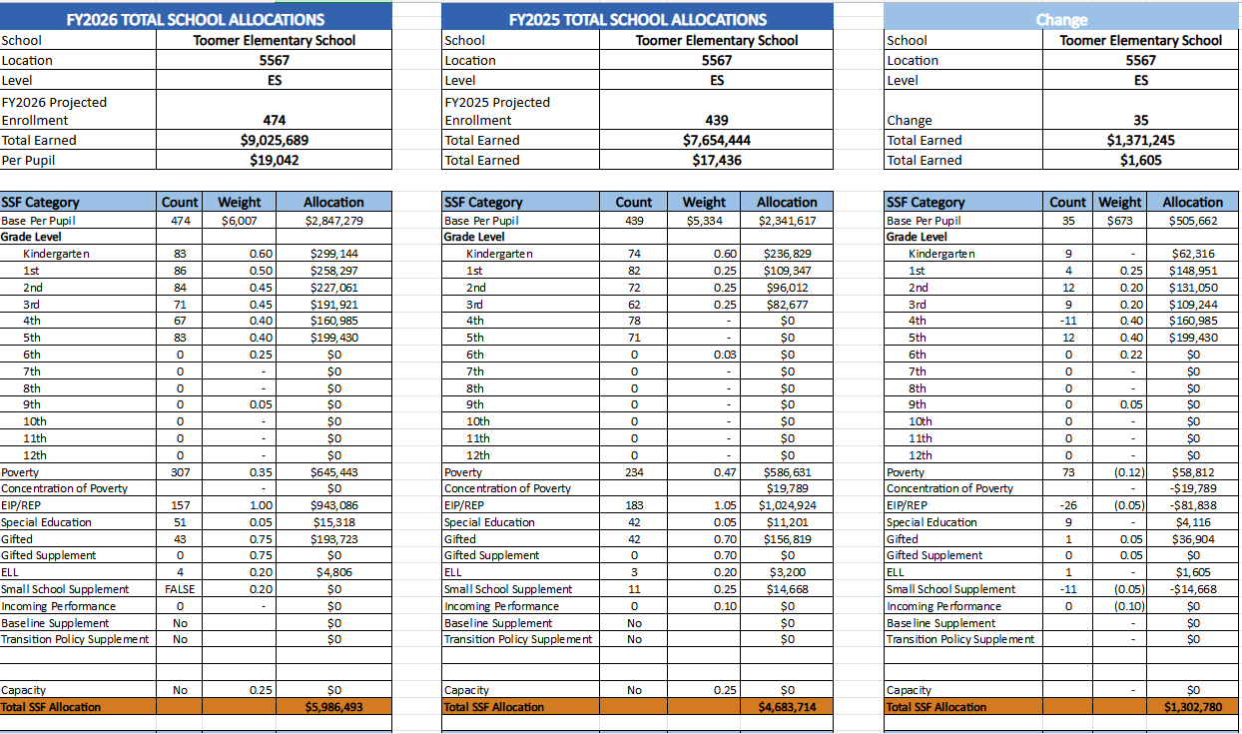
School Allocation Tab Overview
The Allocation Tab has 3 tables that show the allocations for FY26, FY25, and the Change in each area. This helps you understand how our school earned funds and positions for FY26 in comparison to FY25, and how changes in each line impact our overall school budget.

Slide 20
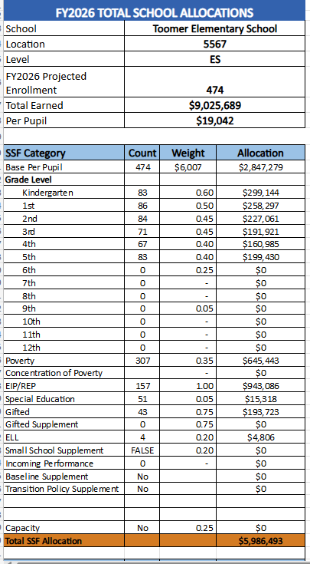
Toomer SSF Allocations

Slide 21
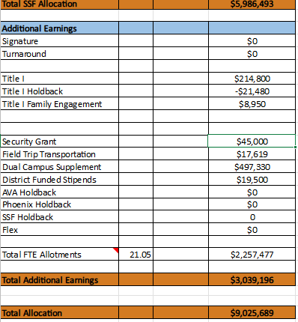
Toomer Additional Earnings

Slide 22
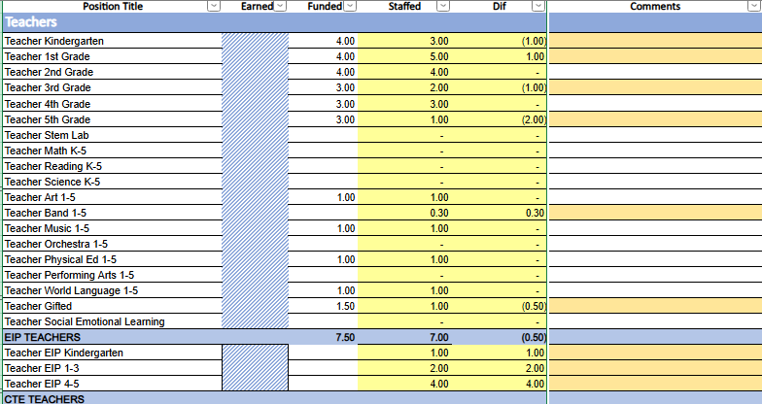
Summary Tab Overview
The Summary Tab provides a summary of the staff in our school. The columns show how many positions are:
Earned – positions allocated by district departments. There is no school-level flexibility with these positions.
Funded – District’s recommended staffing for positions where there is school-level flexibility with staffing the position.
Staffed – This shows how the position is currently staffed at the school.
Difference—This shows the difference between the recommendation in the Funded column and the Staffed Column.
Comments: The principal must provide comments if there is a difference in what is Funded and Staffed. Principals and GO Teams will discuss the rationale provided for the Comments section.

Slide 23
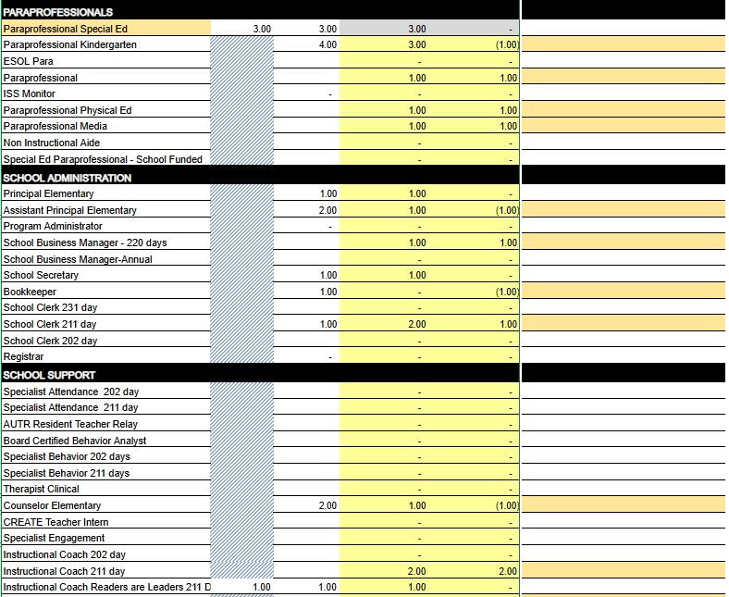

Slide 24
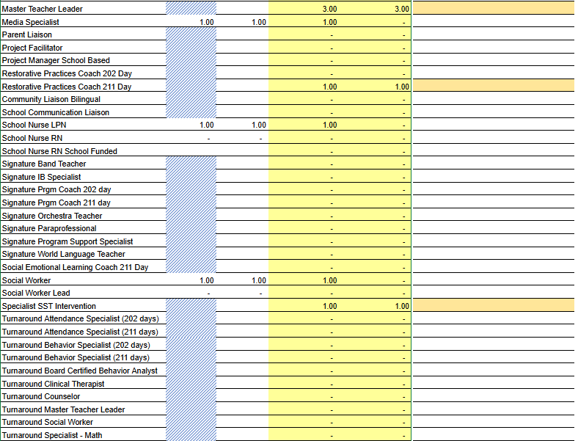

Slide 25
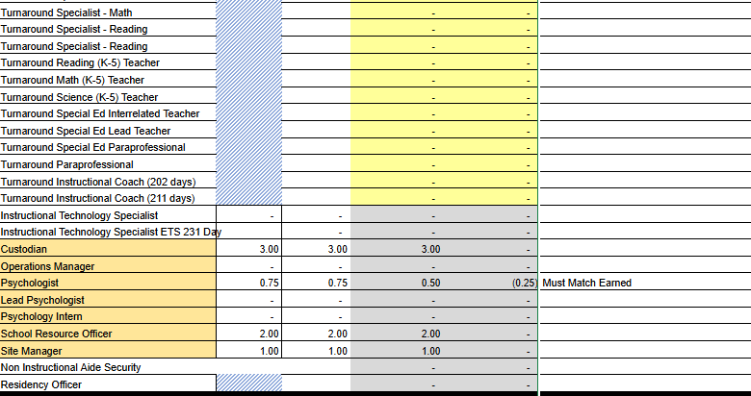

Slide 26
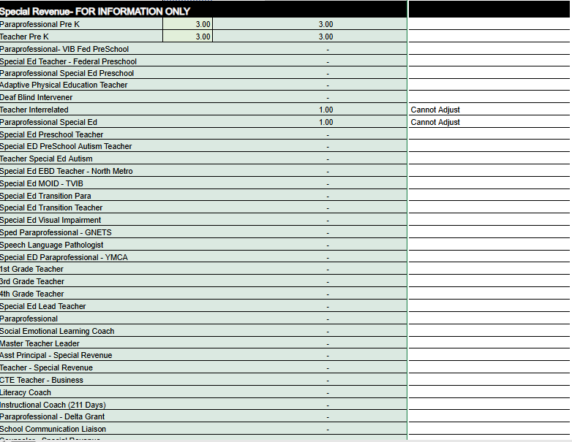

Slide 27
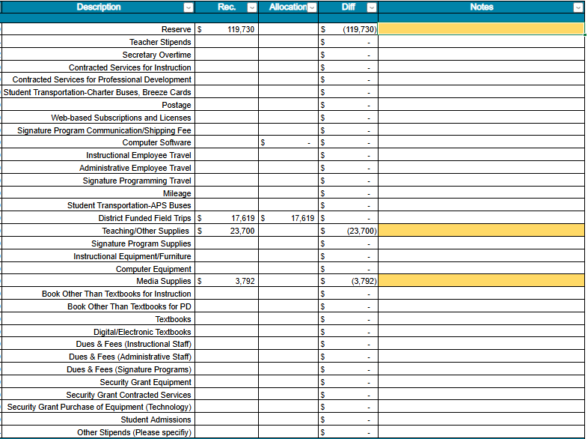
Non-Staffing Tab Overview
The Non-Staffing Tab shows how funds are allocated for non-staff items in the school. There is school-level flexibility for most of these items. The tab has columns for:
Recommended—District’s recommended amount to spend on the line item.
Allocation – This shows how much money has been allocated towards the line item.
Difference—This shows the difference between the recommended amount and the allocation.
Notes: The principal must provide comments if there is a difference in what is Recommended and what is Allocated. Principals and GO Teams will discuss the rationale for the notes section.

Slide 28
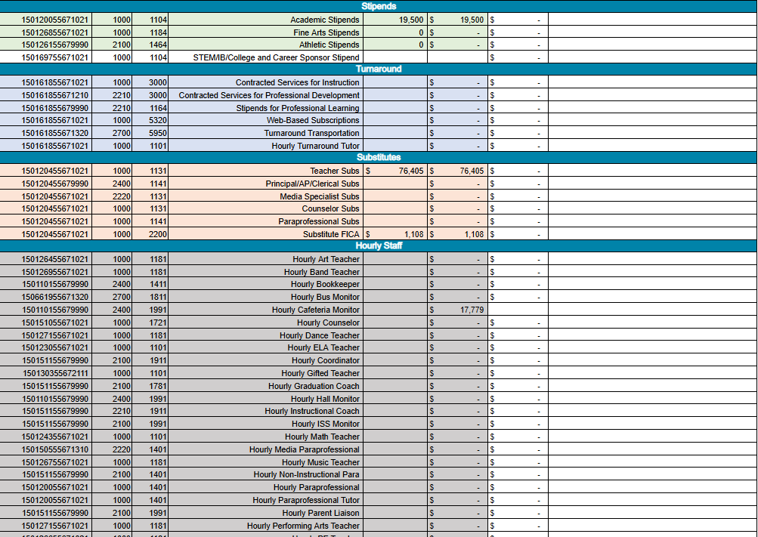

Slide 29
Signature and Turnaround Fund Process Overview
Overview
Process
* The district is piloting a zero-based budgeting (ZBB) process for Signature and Turnaround Program Funds this year.
* Zero-based budgeting (ZBB) is a budgeting process that allocates funding based on program efficiency and necessity rather than budget history. As opposed to traditional budgeting, no item is automatically included in the next budget.
* As such the initial allocation for these programs at all schools will be $0.
* Principals will develop proposed requests for the personnel and non-personnel they need to support the Signature and/or Turnaround Programs at their schools.
* Principals will share and discuss their proposals and rationale for the proposals with their school GO Team for feedback.
* After discussing with their GO Team, principals will submit their request for review by January 31st. Funding for these programs will be provided the week of February 3rd.

Slide 30
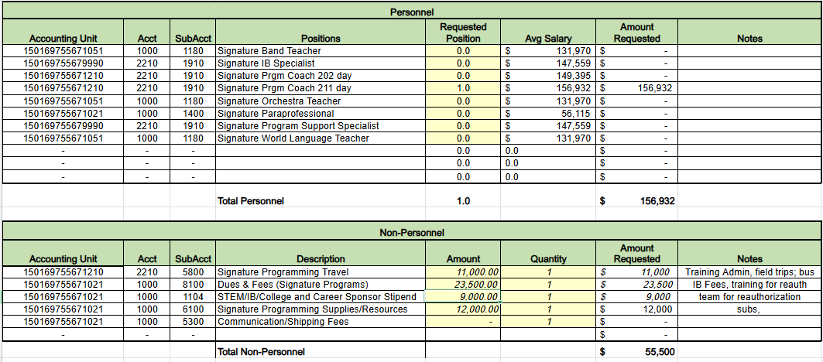
Proposed FY26 Signature Program Fund Request

Slide 31
Proposed Rationale for FY26 Signature Program Fund Requests
FY26 Signature Program Fund Request | Rationale
Signature Programing Coach Stipends for IB team for self study | Dedicated instructional coach to support all aspects of the IB program.
Field trips for immersion into units 1 per grade level. Includes admissions and transportation | Allows students to experience the environment and people outside of the four walls of school.
IB Fees and Training Fees for re-authorization with travel | Annual IB Fees. Admin. will attend a face to face training on re-authorization.

Slide 32
What’s Next?
February
GO Team Feedback Meeting(s) February 10 - 14
ACTION (i.e.- GO Team votes) on draft budget before February 14
Cluster Superintendent Review (February 17-21)
HR Staffing Conferences (February 24– February 27)
March
Final GO Team Approval Meeting (AFTER your school’s Staffing Conference and BEFORE Friday, March 14)
ACTION (i.e.- GO Team votes) on final budget recommendation before March 14

Slide 33
Questions?
Thank you for your time and attention.

Slide 34
Information Items

Slide 35
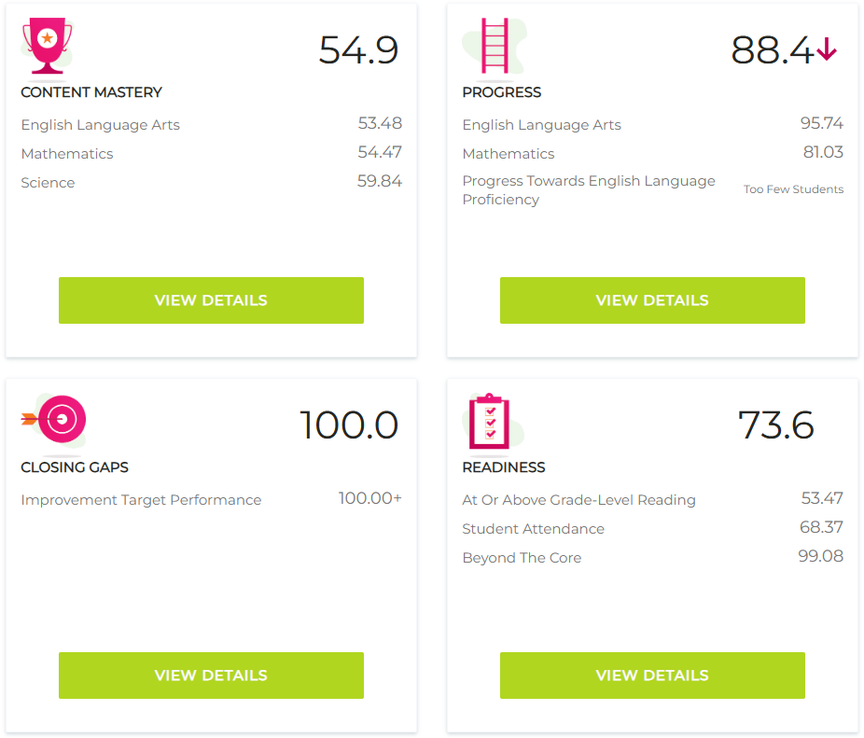
Principal’s Report

Slide 36
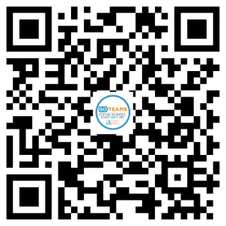
declare by February 28!
tinyAPS.com/?2025GOTeamDeclaration

Slide 37
Thank you

